Slide 1

Cooking with GCP and Splunk
Module 2 : Configuring the Splunk Add-on for GCP
Nic Stone | Solutions Engineer
Global Strategic Alliances Partner Integrations

Slide 2
Setting up the Splunk Add-on for GCP
Configuring Splunk to collect data from GCP
Adding the GCP Service account credential to the Add-on
Setting up a GCP Cloud Billing input
Setting up GCP Cloud Monitoring input
Setting up a generic Cloud Pub/Sub input
Setting up a GCP Stackdriver logging Cloud Pub/Sub input

Slide 3
Setting up the Splunk Add-on for GCP
Initial notes
Please create a GitHub Issue for any typos, bugs, issues, enhancement requests, etc.

Slide 4
Adding the GCP service account to the Splunk Add-on for GCP
First time Add-on setup.

Slide 5
Table of Contents: Adding the GCP service account
What’s in this section?
This section will walk through
Finding your Service account key
Navigating to the Splunk Add-on for GCP in Splunk
Getting the Service account key string
Adding your Service account key to the Splunk Add-on for GCP

Slide 6
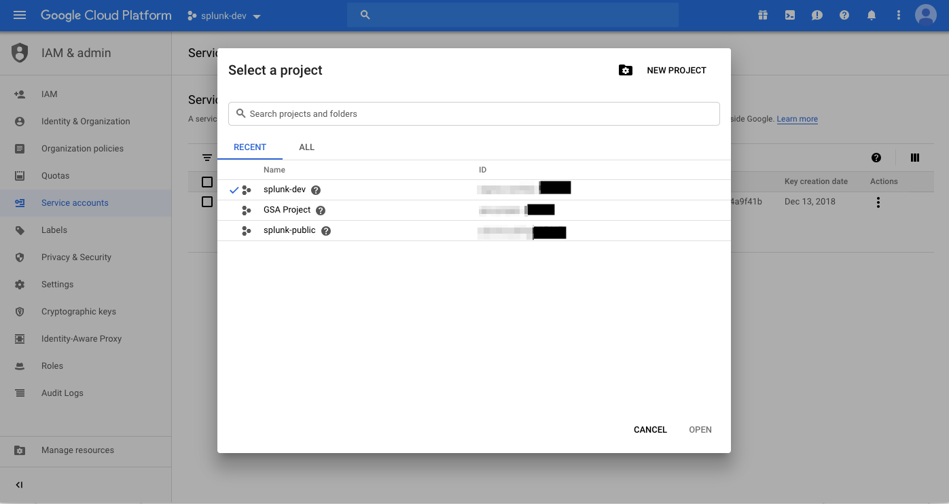
Finding your Service account key – Part 1
Find the already generated JSON key file, or generate a new one.
In the first part of the previous module, you should have generated a JSON key file as a part of Service account creation
The name format of the key file is the project ID followed by an alphanumeric string
project-id-123456-123aa45a678a.json
Refer to the steps in the first section of Module 1 (Creating a GCP Service account) for regenerating a key if you cannot locate the JSON key file created earlier
Click here for project list
Project IDs here

Slide 7
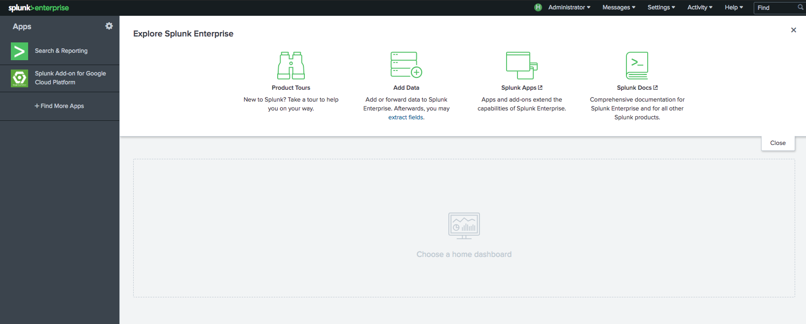
Navigating to the Splunk Add-on for GCP – Part 2
Click the Splunk Add-on for GCP menu icon
Open the GCP Add-on icon

Slide 8
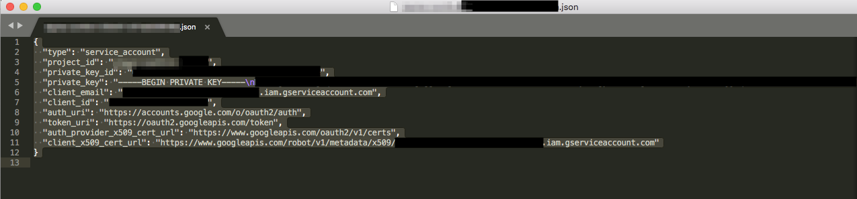
Getting the Service account key string – Part 3
Open the Service account JSON key file in a text editor. Select the entire contents of the file and copy, you will need to paste it in the next step
Copy the entire file

Slide 9
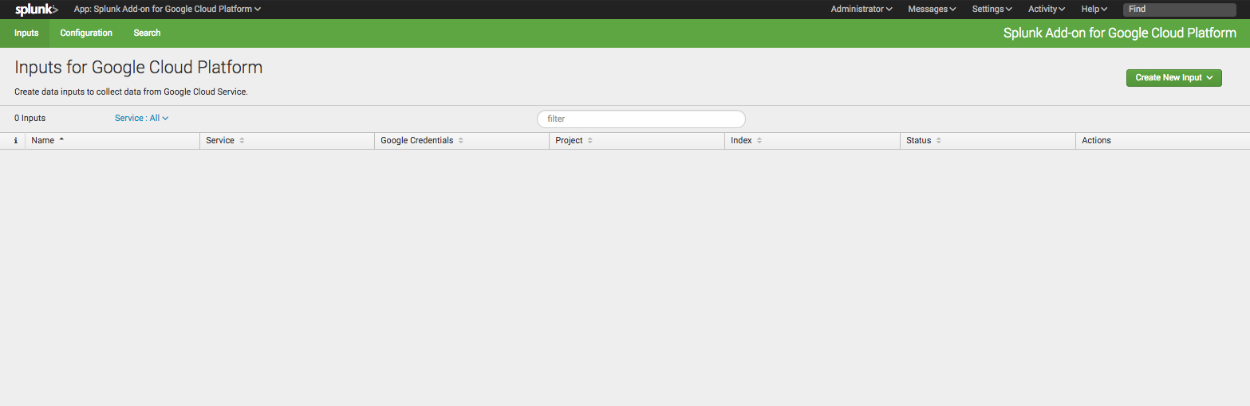
Adding your Service account key – Part 4
Open the Configuration tab in the Splunk Add-on for GCP
Click here

Slide 10
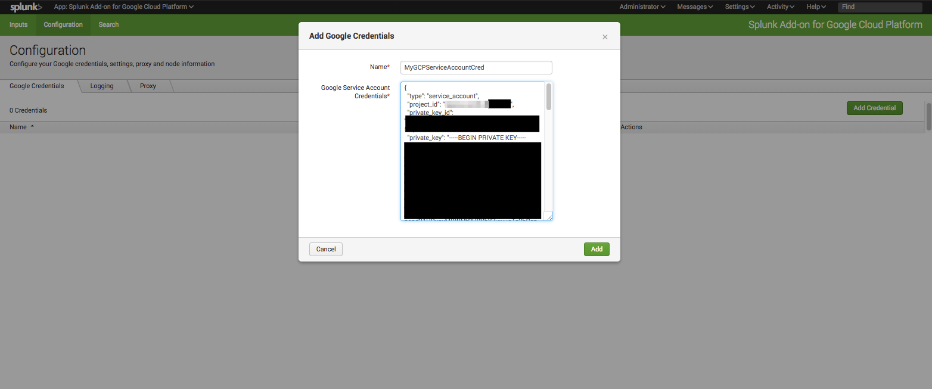
Adding your Service account key – Part 4
Name the credential, then paste the JSON Key file from the previous step into the Google Service Account Credentials text box. Click Add.
Copy and paste the JSON Service account key here

Slide 11
Set up GCP Cloud Monitoring input
Collect Stackdriver monitoring metrics in Splunk

Slide 12
Table of Contents: Set up a GCP Cloud Billing input
What’s in this section?
This section will walk through
Setting up a Cloud Monitoring input for the Splunk Add-on for GCP
Confirming successful input creation and set up
Confirming successful data ingestion using Splunk search

Slide 13
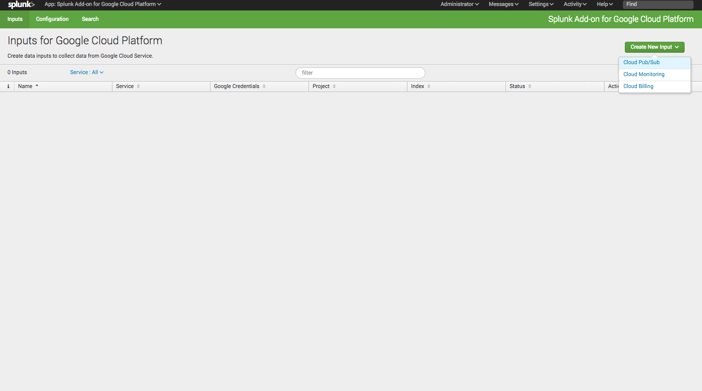
Setting up a Cloud Monitoring input for the Splunk Add-on for GCP – Part 1
From the inputs tab of the Splunk Add-on for GCP, click Create New Input and select Cloud Monitoring from the dropdown menu.
Select Cloud Monitoring

Slide 14
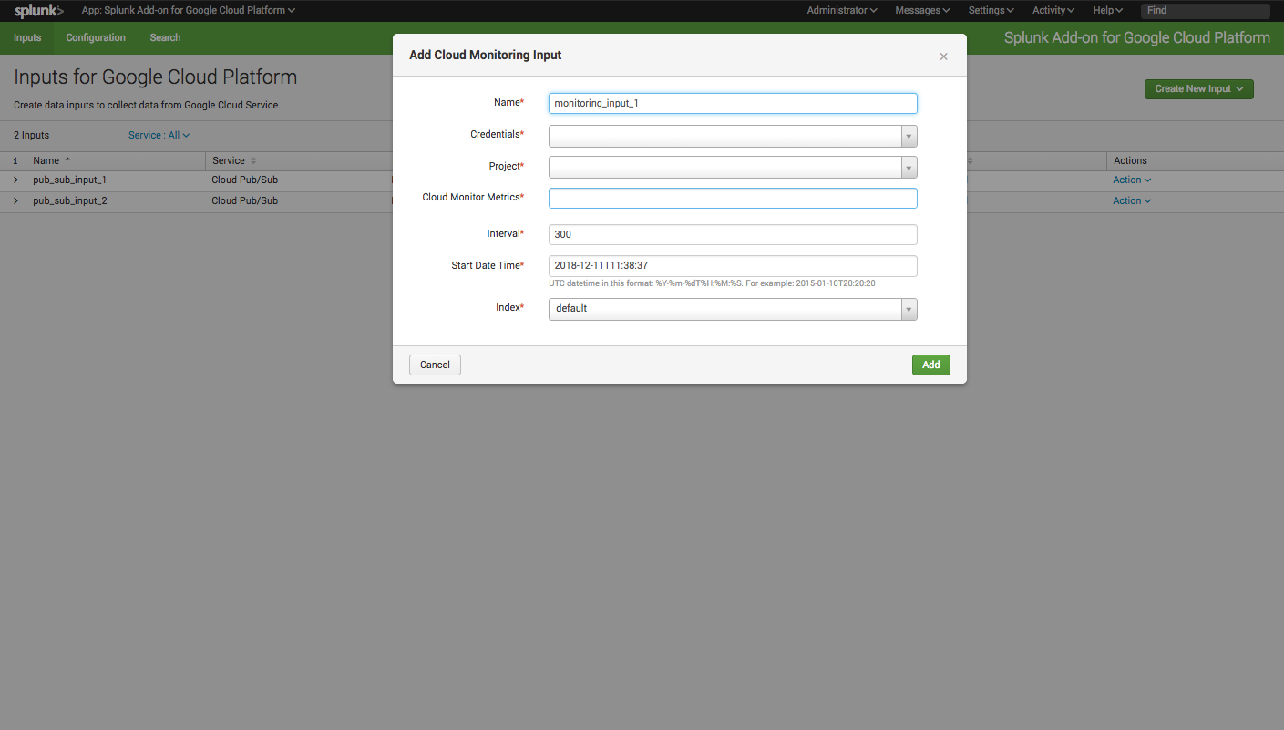
Setting up a Cloud Monitoring input for the Splunk Add-on for GCP – Part 1
Provide a descriptive name for the input
Use names without spaces!
Provide a name for the input

Slide 15
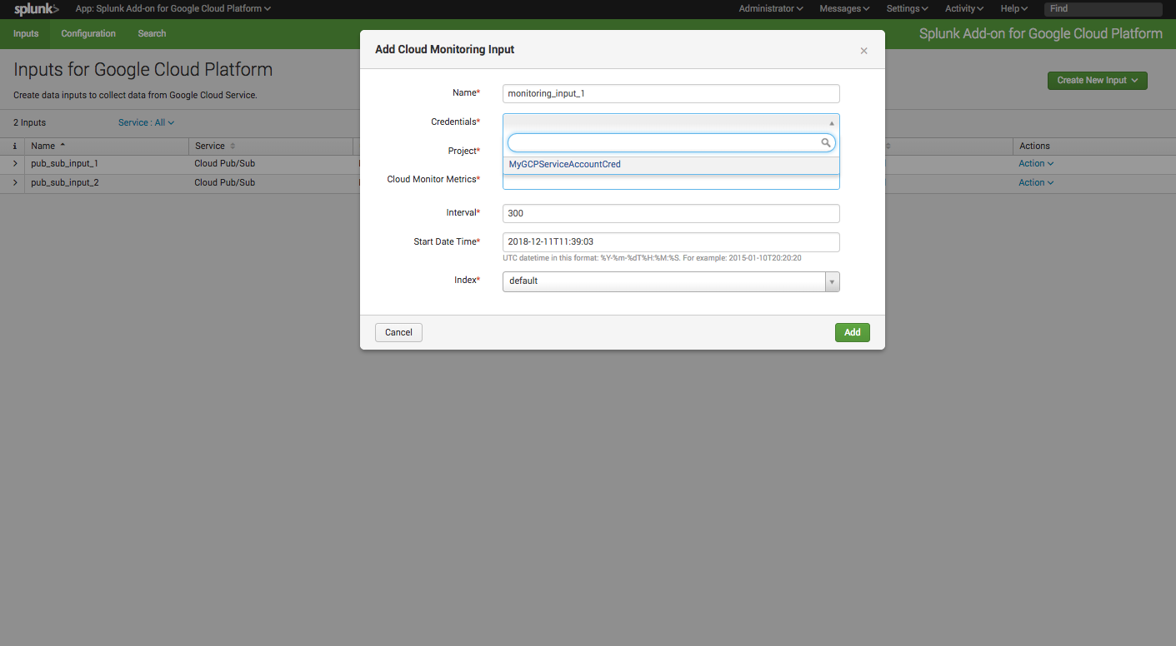
Setting up a Cloud Monitoring input for the Splunk Add-on for GCP – Part 1
Select the credential that was added in the previous section
Select a credential

Slide 16

Setting up a Cloud Monitoring input for the Splunk Add-on for GCP – Part 1
Provide the GCP project for the input
Select the GCP project

Slide 17
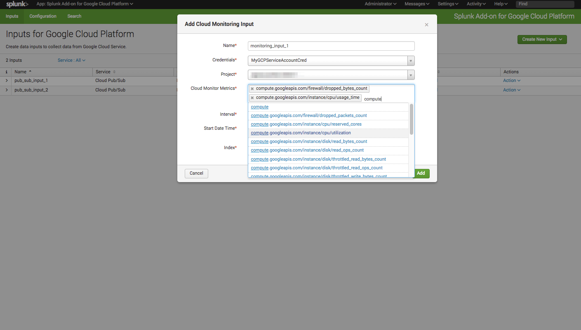
Setting up a Cloud Monitoring input for the Splunk Add-on for GCP – Part 1
Select one or more Cloud Monitoring metrics to collect as a part of this input. Multiple Cloud Monitoring inputs can be created in the Add-on for logical separation, etc.
Select one or more Cloud Monitoring metrics

Slide 18
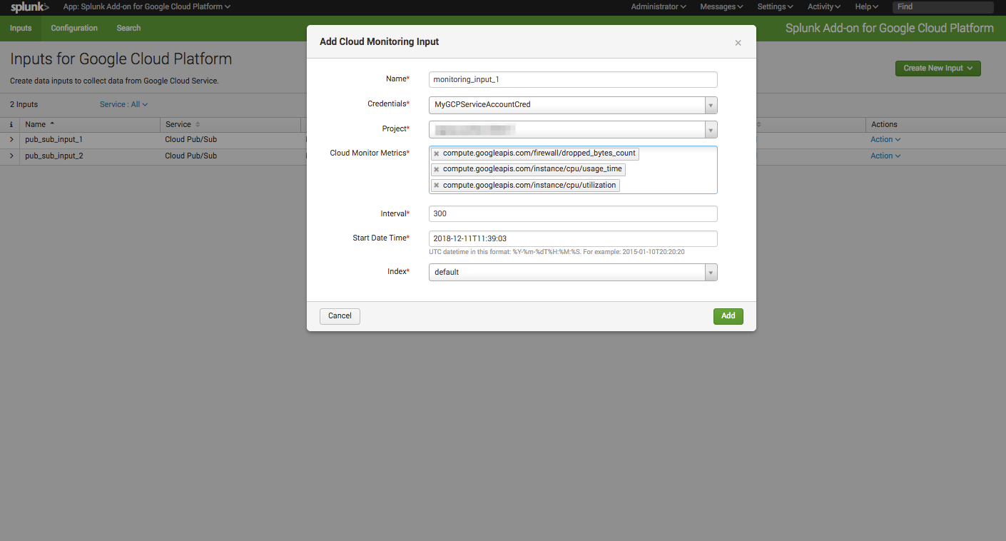
Setting up a Cloud Monitoring input for the Splunk Add-on for GCP – Part 1
If needed, edit the polling interval (in seconds), the starting time from which to collect metrics, and the Splunk index where results will be stored. Click Add.

Slide 19
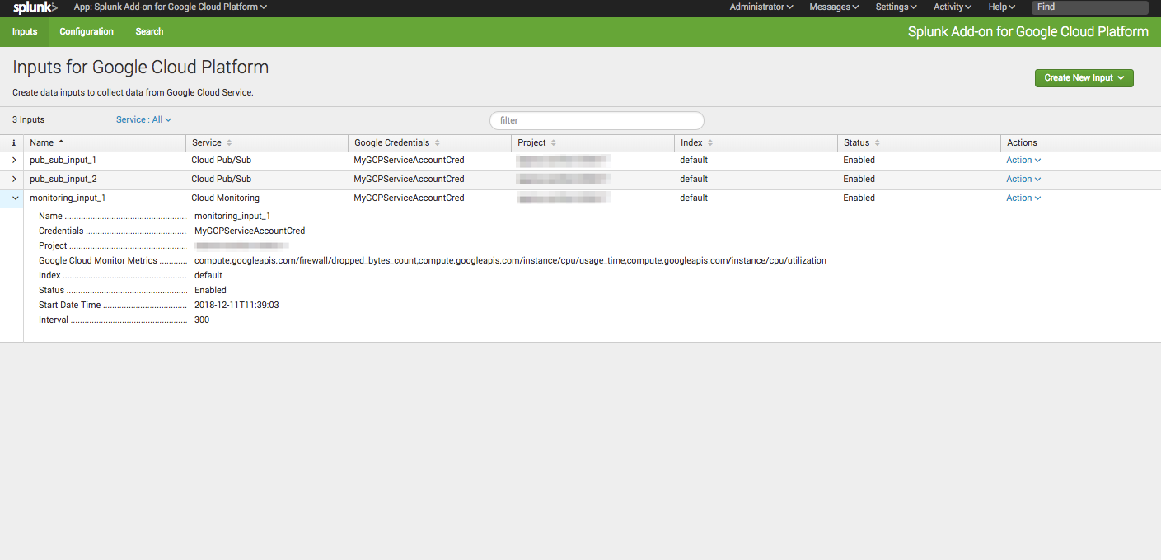
Confirming successful input creation and set up – Part 2
All inputs are visible in the Inputs tab of the Splunk Add-on for GCP, confirm that the index and interval are both correct, and that the status is Enabled.

Slide 20
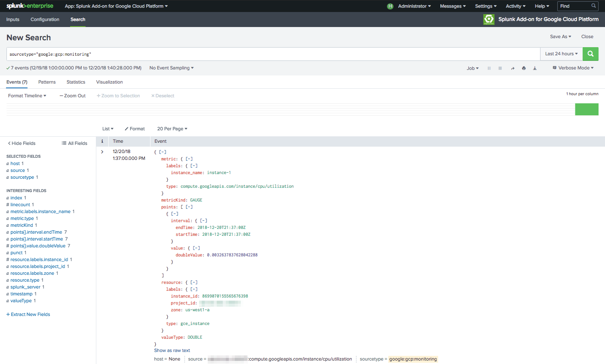
Confirming successful data ingestion using Splunk search – Part 3
Enter sourcetype=“google:gcp:monitoring” as your search query in the Splunk search bar. Confirm the time range is valid. If the input was successfully created, you should see your test event/s.

Slide 21
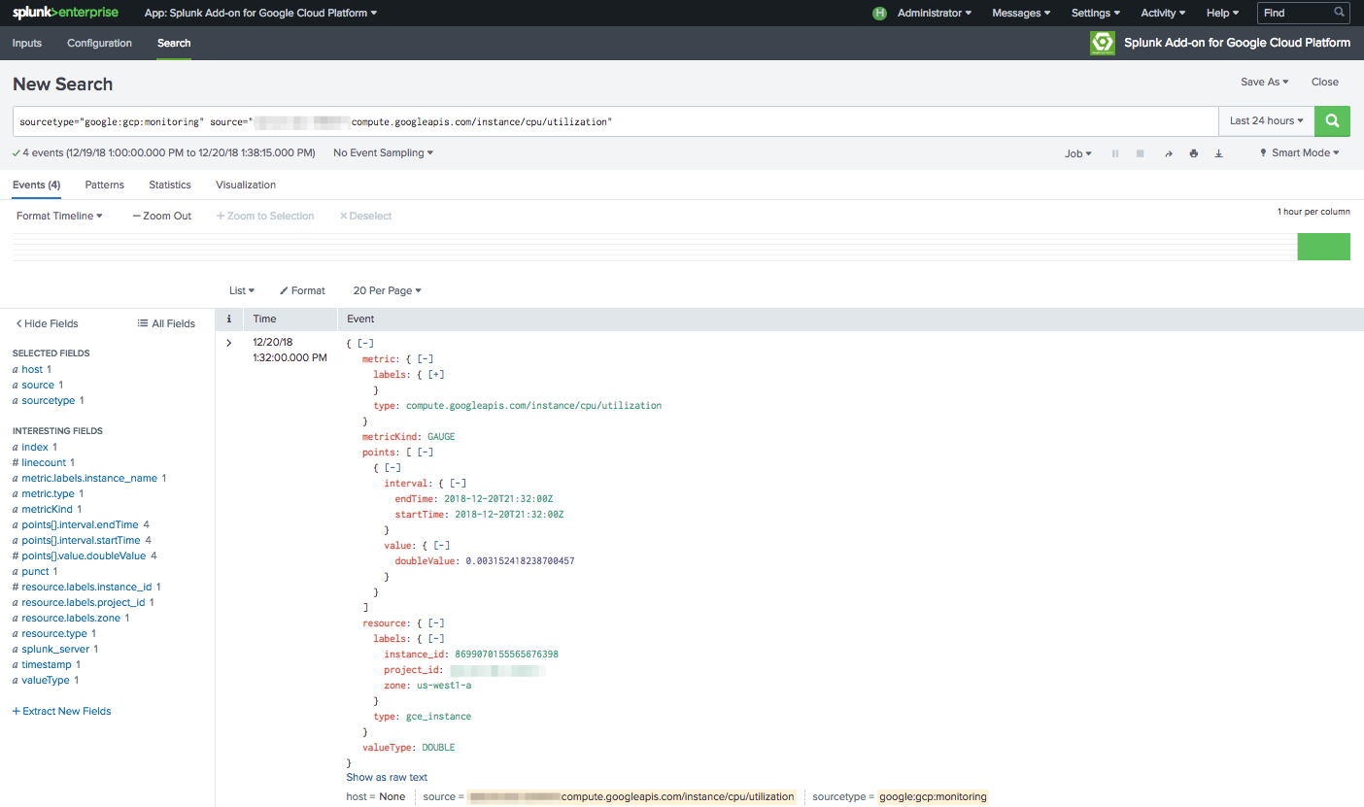
Confirming successful data ingestion using Splunk search – Part 3
To select a specific Cloud Monitoring metric, add a source filter (format: project:metric) to your search query. As an example, for the instance utilization metric: source=”my-project-123456:compute.googleapis.com/instance/cpu/utilization"

Slide 22
Set up a generic GCP Cloud Pub/Sub input
Collect data from a preconfigured generic Pub/Sub subscription

Slide 23
Table of Contents: Set up a generic GCP Cloud Pub/Sub input
What’s in this section?
This section will walk through
Setting up a generic Cloud Pub/Sub input to the Splunk Add-on for GCP
Confirming successful input creation
Publishing a test message to the subscription
Confirming successful data ingestion using Splunk search

Slide 24
Setting up a generic Cloud Pub/Sub input for the Splunk Add-on for GCP – Part 1
From the inputs tab of the Splunk Add-on for GCP, click Create New Input and select Cloud Pub/Sub from the dropdown menu.
Select Cloud Pub/Sub

Slide 25
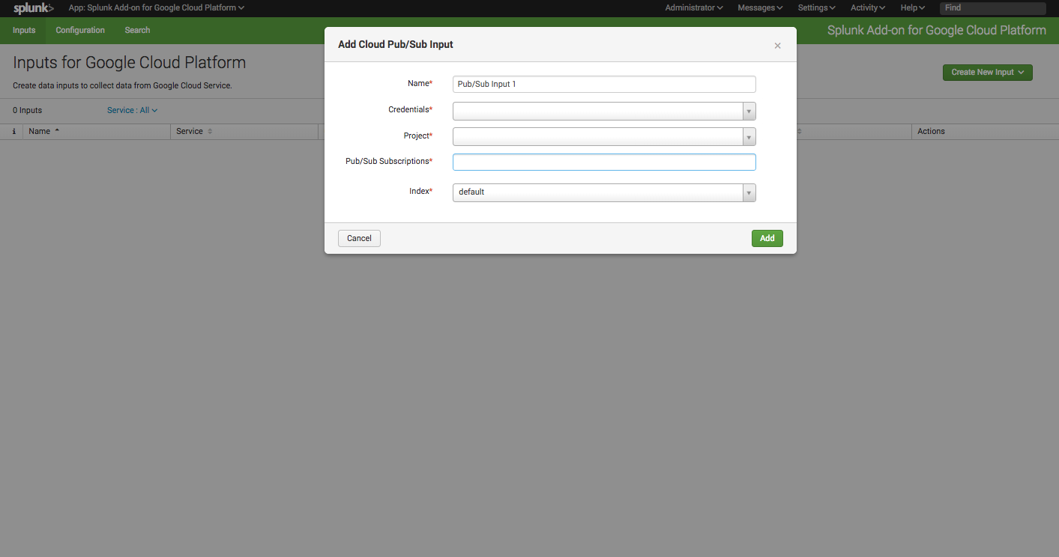
Setting up a generic Cloud Pub/Sub input for the Splunk Add-on for GCP – Part 1
Provide a descriptive name for the input
Use names without spaces!
Provide a name for the input

Slide 26
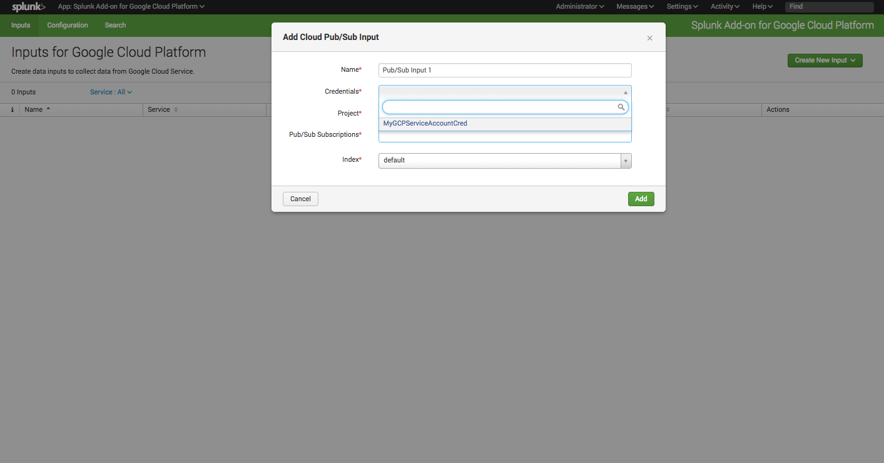
Setting up a generic Cloud Pub/Sub input for the Splunk Add-on for GCP – Part 1
Select the credential that was added in the previous section
Select a credential

Slide 27
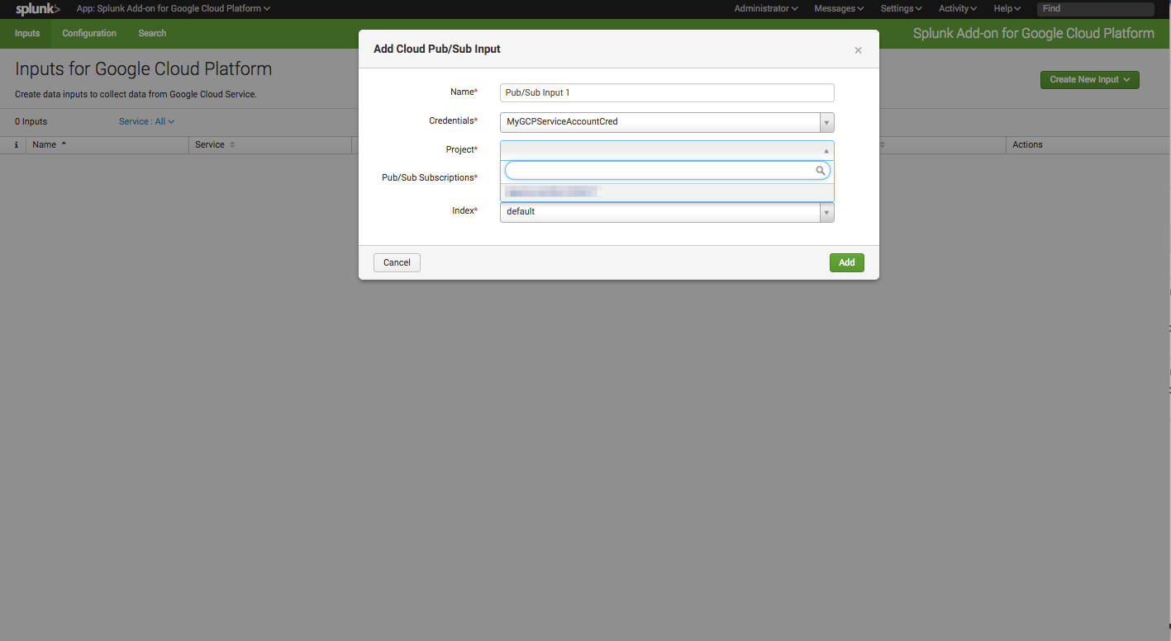
Setting up a generic Cloud Pub/Sub input for the Splunk Add-on for GCP – Part 1
Select the project where the GCP setup in Module 1 was completed
Select a project

Slide 28
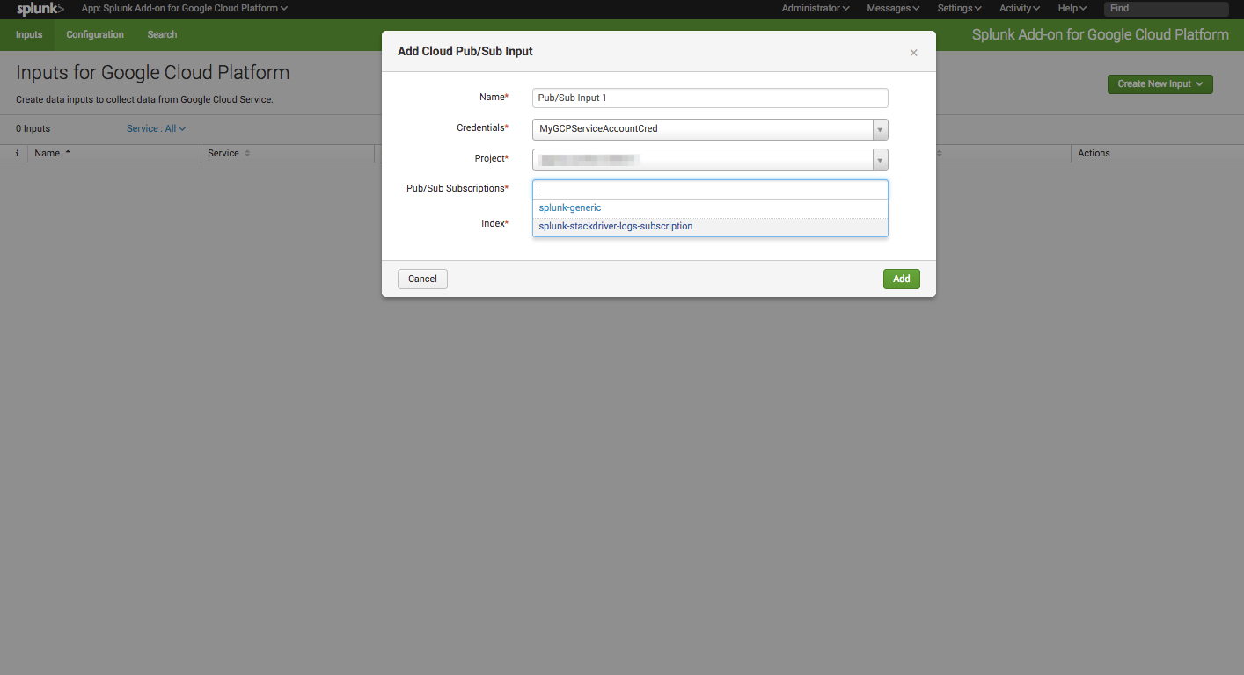
Setting up a generic Cloud Pub/Sub input for the Splunk Add-on for GCP – Part 1
Select the Stackdriver logging Pub/ Sub subscription set up in Module 1.
Select a subscription

Slide 29
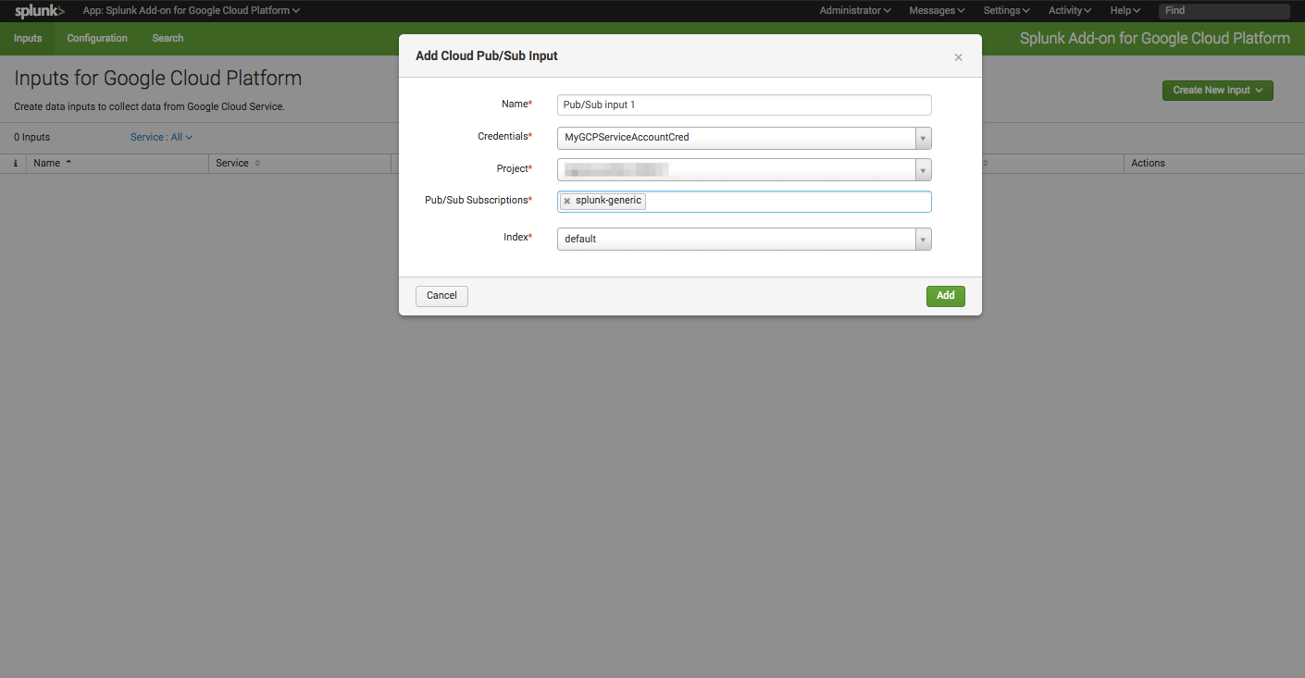
Setting up a a generic Cloud Pub/Sub input for the Splunk Add-on for GCP – Part 1
Select an index to send events from this input into, then click Add.

Slide 30
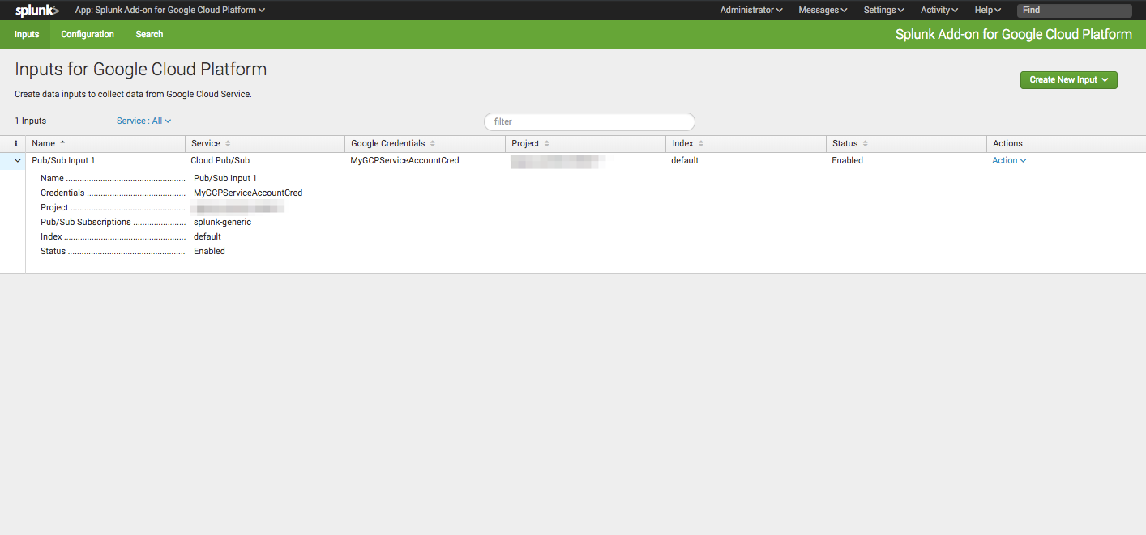
Confirming successful input creation and set up – Part 2
All inputs are visible in the Inputs tab of the Splunk Add-on for GCP, confirm that the index is correct and that the status is Enabled.

Slide 31
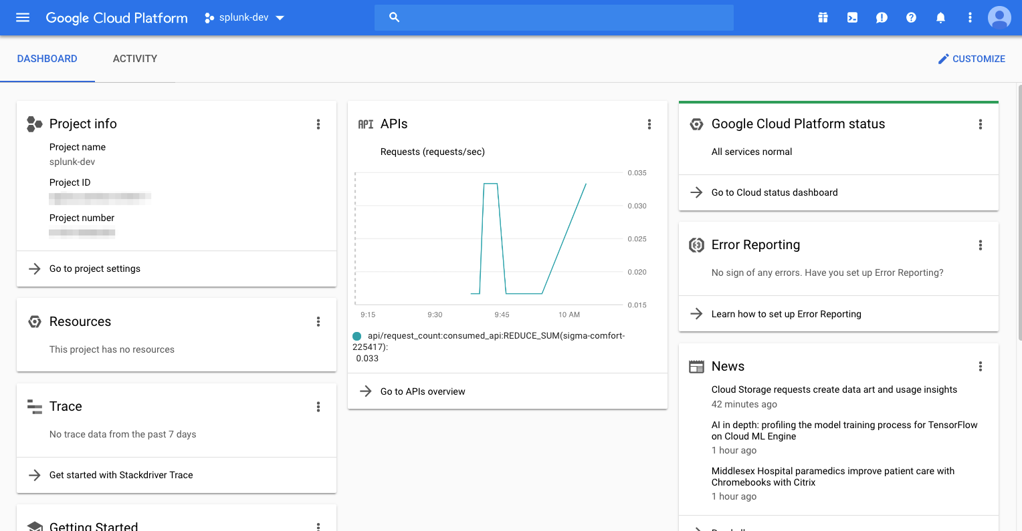
Publishing a test message to the subscription – Part 3
If the Pub/Sub subscription has consistent events coming in, continue to Part 3, otherwise we will manually generate events from the GCP console to test our input.
Navigate to the GCP console

Slide 32
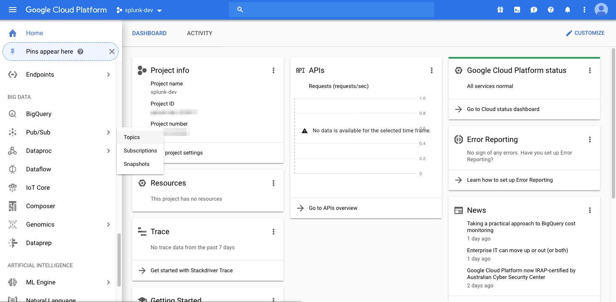
Publishing a test message to the subscription – Part 3
From the GCP Console Service menu, scroll to Pub/Sub, click and select Topics
Here
Then click here

Slide 33
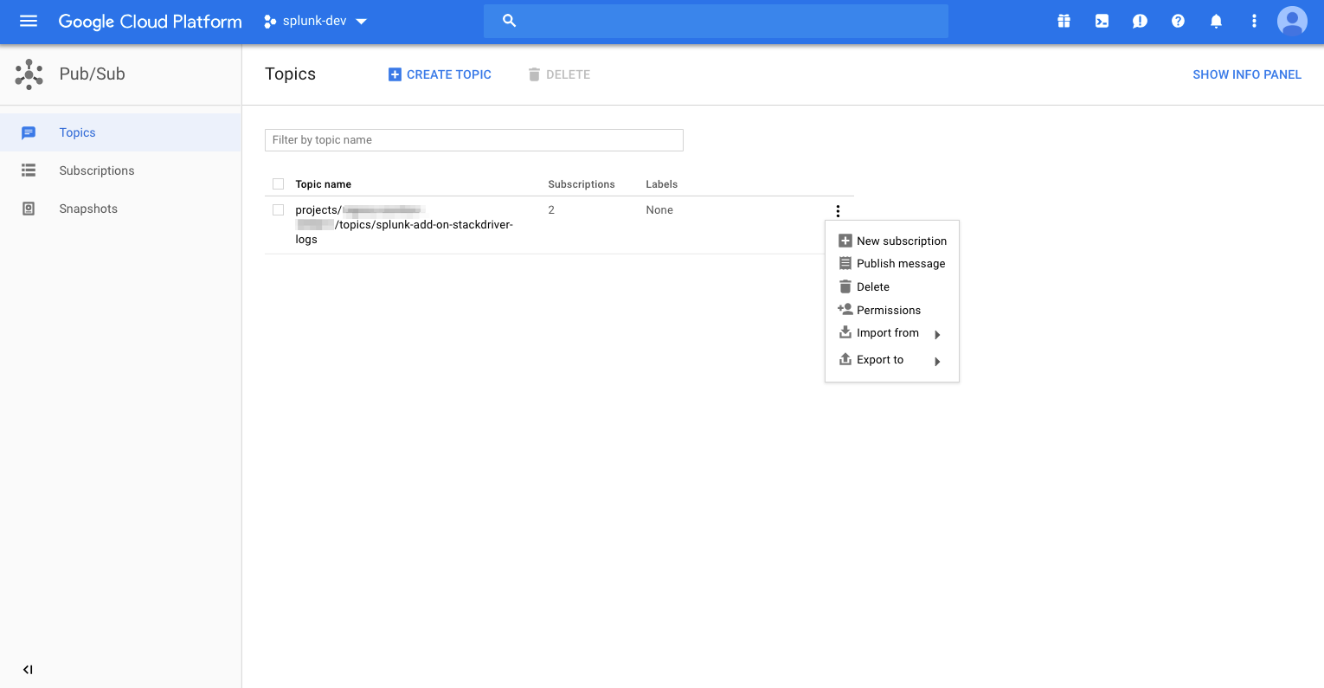
Publishing a test message to the subscription – Part 3
For the topic of the subscription whose Splunk input you are trying to test, click the menu and select Publish message.
Click here

Slide 34
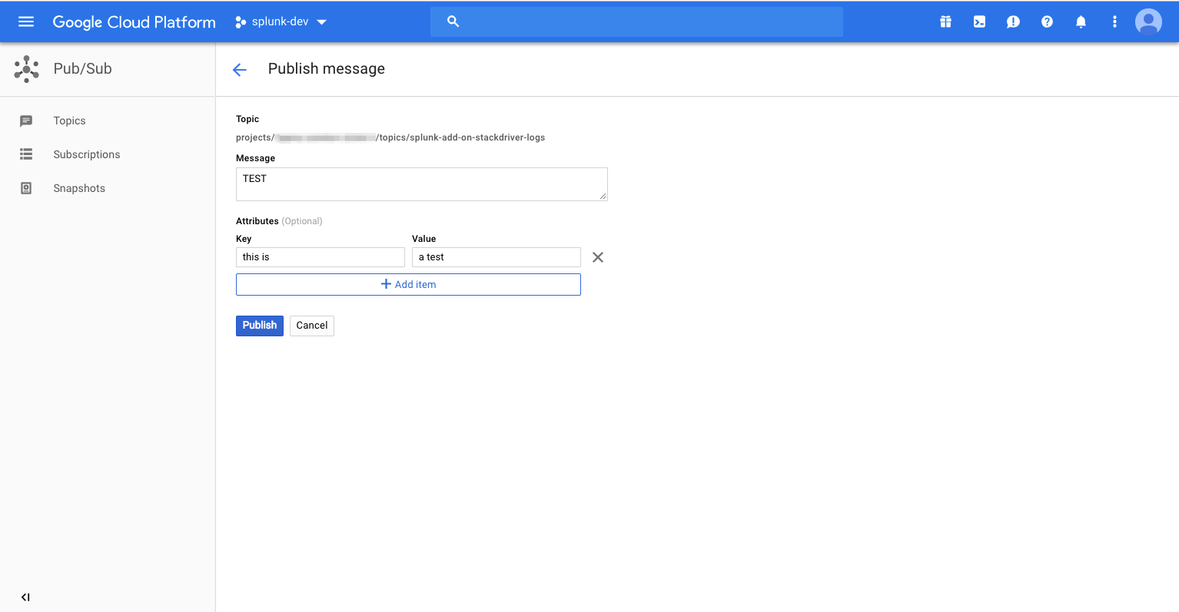
Publishing a test message to the subscription – Part 3
Provide a message and some test key value pairs to the message. Click Publish.

Slide 35
Publishing a test message to the subscription – Part 3
Message availability in Splunk.
There may be some delay between creating the test event and Splunk actually ingesting it. Allow for 5-10 minutes before troubleshooting.

Slide 36
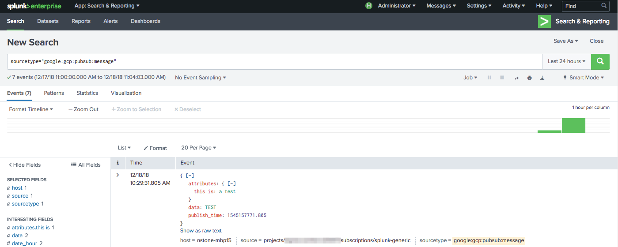
Confirming successful data ingestion using Splunk search – Part 4
Enter sourcetype="google:gcp:pubsub:message” as your search query in the Splunk search bar. Confirm the time range is valid. If the input was successfully created, you should see your test event/s.

Slide 37
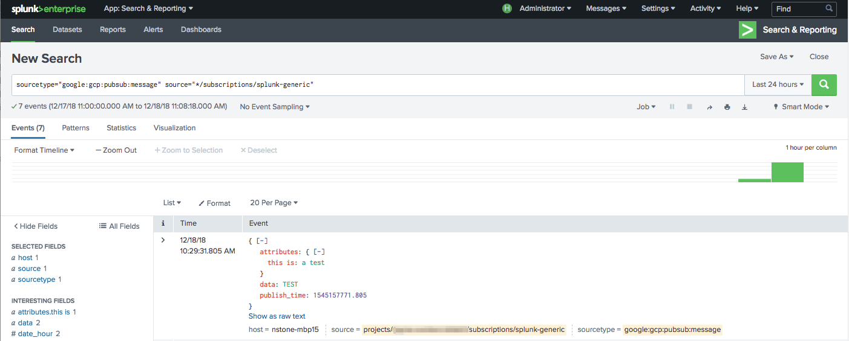
Confirming successful data ingestion using Splunk search – Part 4
If you have multiple inputs configured, test a single subscription by specifying source="*/subscriptions/splunk-generic”. Replace splunk-generic with the subscription name you are testing.

Slide 38
Set up a Stackdriver logging Cloud Pub/Sub input
Collect data from a preconfigured Stackdriver logging Pub/Sub subscription

Slide 39
Table of Contents: Set up a Stackdriver logging Cloud Pub/Sub input
What’s in this section?
This section will walk through
Setting up a Stackdriver logging Cloud Pub/Sub input for the Splunk Add-on for GCP
Confirming successful input creation
Publishing a test message to the subscription
Confirming successful data ingestion using Splunk search

Slide 40
Setting up a Stackdriver Cloud Pub/Sub input for the Splunk Add-on for GCP – Part 1
From the inputs tab of the Splunk Add-on for GCP, click Create New Input and select Cloud Pub/Sub from the dropdown menu.
Select Cloud Pub/Sub

Slide 41
Setting up a Stackdriver logging Cloud Pub/Sub input for the Splunk Add-on for GCP – Part 1
Provide a descriptive name for the input
Use names without spaces!
Provide a name for the input

Slide 42
Setting up a Stackdriver logging Cloud Pub/Sub input for the Splunk Add-on for GCP – Part 1
Select the credential that was added in the previous section
Select a credential

Slide 43
Setting up a Stackdriver logging Cloud Pub/Sub input for the Splunk Add-on for GCP – Part 1
Select the project where the GCP setup in Module 1 was completed
Select a project

Slide 44
Setting up a Stackdriver logging Cloud Pub/Sub input for the Splunk Add-on for GCP – Part 1
Select the Stackdriver logging Pub/ Sub subscription set up in Module 1.
Select a subscription

Slide 45
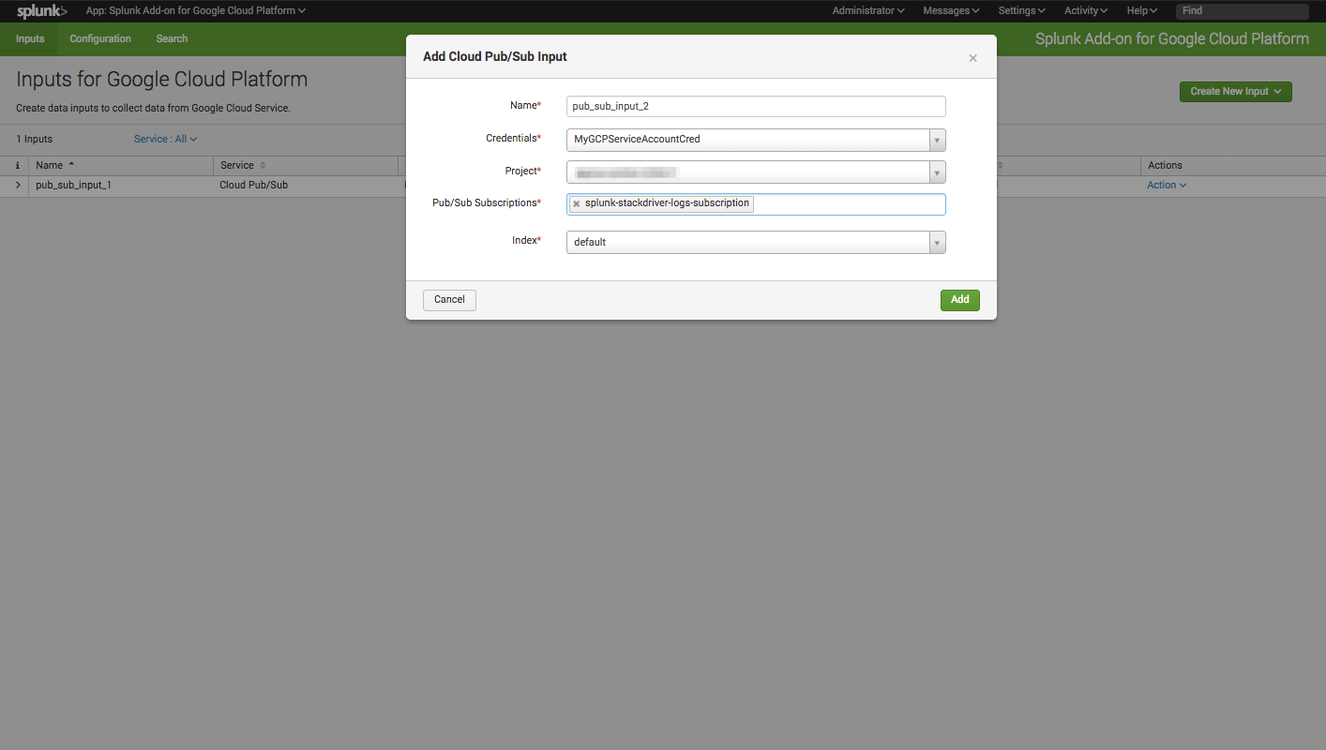
Setting up a Stackdriver logging Cloud Pub/Sub input for the Splunk Add-on for GCP – Part 1
Select an index to send events from this input into, then click Add.

Slide 46
Confirming successful input creation and set up – Part 2
All inputs are visible in the Inputs tab of the Splunk Add-on for GCP, confirm that the index is correct and that the status is Enabled.

Slide 47
Publishing a test message to the subscription – Part 3
If the Pub/Sub subscription has consistent events coming in, continue to Part 3, otherwise we will manually generate events from the GCP console to test our input.
Navigate to the GCP console

Slide 48
Publishing a test message to the subscription – Part 3
From the GCP Console Service menu, scroll to Pub/Sub, click and select Topics
Here
Then click here

Slide 49
Publishing a test message to the subscription – Part 3
For the topic of the subscription whose Splunk input you are trying to test, click the menu and select Publish message.
Click here

Slide 50
Publishing a test message to the subscription – Part 3
Provide a message and some test key value pairs to the message. Click Publish.

Slide 51
Publishing a test message to the subscription – Part 3
Message availability in Splunk.
There may be some delay between creating the test event and Splunk actually ingesting it. Allow for 5-10 minutes before troubleshooting.

Slide 52
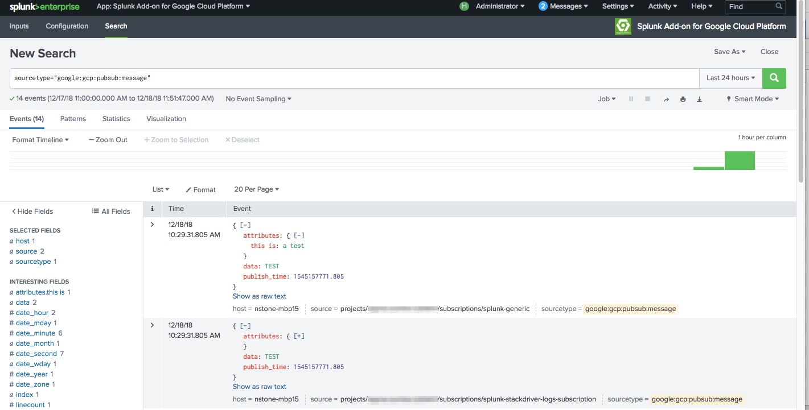
Confirming successful data ingestion using Splunk search – Part 4
Enter sourcetype="google:gcp:pubsub:message” as your search query in the Splunk search bar. Confirm the time range is valid. If the input was successfully created, you should see events.

Slide 53
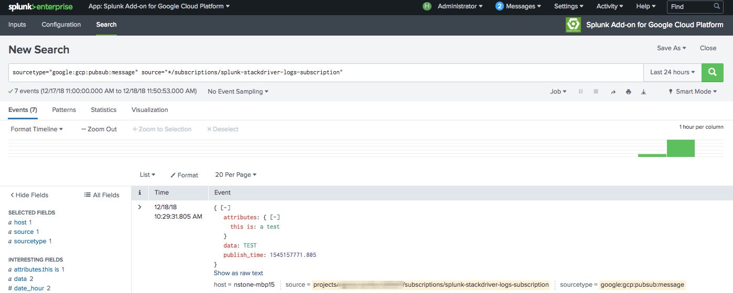
Confirming successful data ingestion using Splunk search – Part 4
If you have multiple inputs configured, test a single subscription by specifying source="*/subscriptions/splunk-stackdriver-logging-subscription”. Replace splunk-stackdriver-logging-subscription with the subscription name you are testing.

Slide 54
Set up a GCP Cloud Billing input
Connect to a preconfigured GCP Billing bucket

Slide 55
Table of Contents: Set up a GCP Cloud Billing input
What’s in this section?
This section will walk through
Setting up a Cloud Billing input for the Splunk Add-on for GCP
Confirming successful input creation
Confirming successful data ingestion using Splunk search

Slide 56
Setting up a Cloud Billing input for the Splunk Add-on for GCP – Part 1
From the inputs tab of the Splunk Add-on for GCP, click Create New Input and select Cloud Billing from the dropdown menu.
Select Cloud Billing

Slide 57
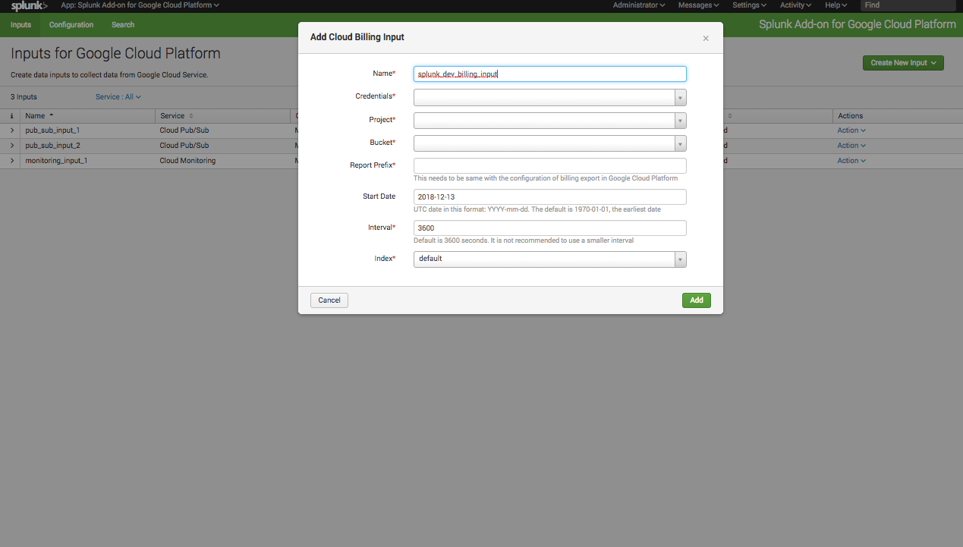
Setting up a Cloud Billing input for the Splunk Add-on for GCP – Part 1
Provide a name for the Cloud Billing input.
Provide a name

Slide 58

Setting up a Cloud Billing input for the Splunk Add-on for GCP – Part 1
Select the GCP credential with the correct permissions to access and read the Cloud Storage bucket
Select credential

Slide 59
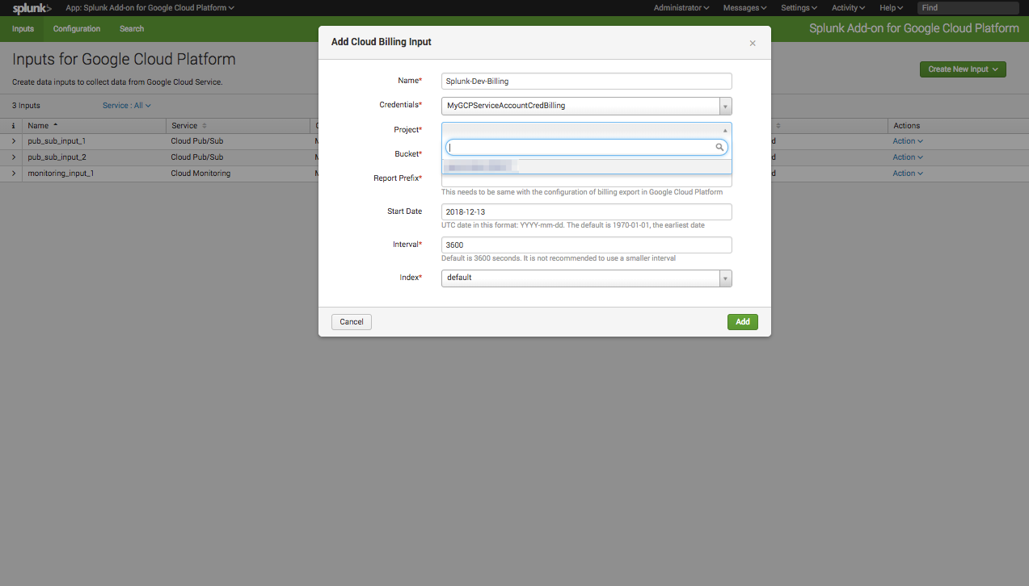
Setting up a Cloud Billing input for the Splunk Add-on for GCP – Part 1
Select the GCP project the billing bucket is in.
Select project

Slide 60

Setting up a Cloud Billing input for the Splunk Add-on for GCP – Part 1
Select the GCP Cloud Storage bucket the billing report is in.
Select bucket

Slide 61
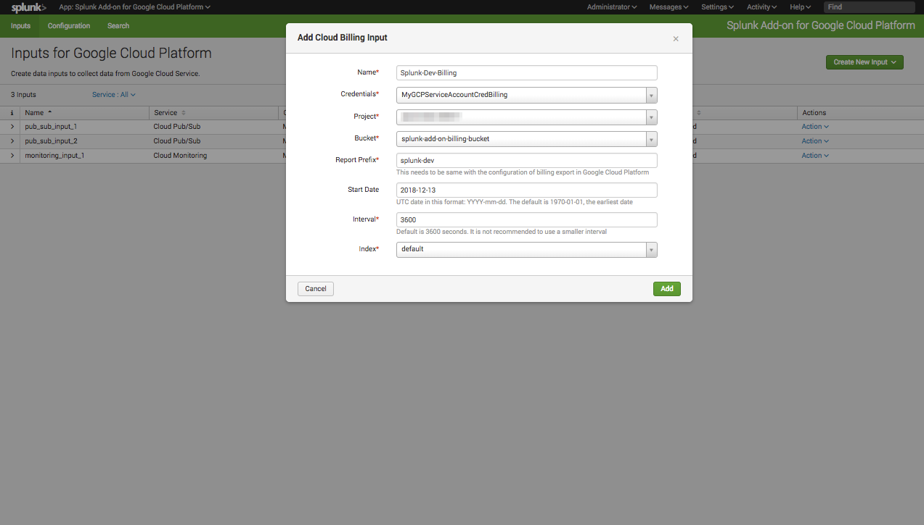
Setting up a Cloud Billing input for the Splunk Add-on for GCP – Part 1
Provide the bucket prefix set in the previous module
Enter Report prefix here

Slide 62
Setting up a Cloud Billing input for the Splunk Add-on for GCP – Part 1
Confirm the Cloud Billing input settings, then click Add.

Slide 63
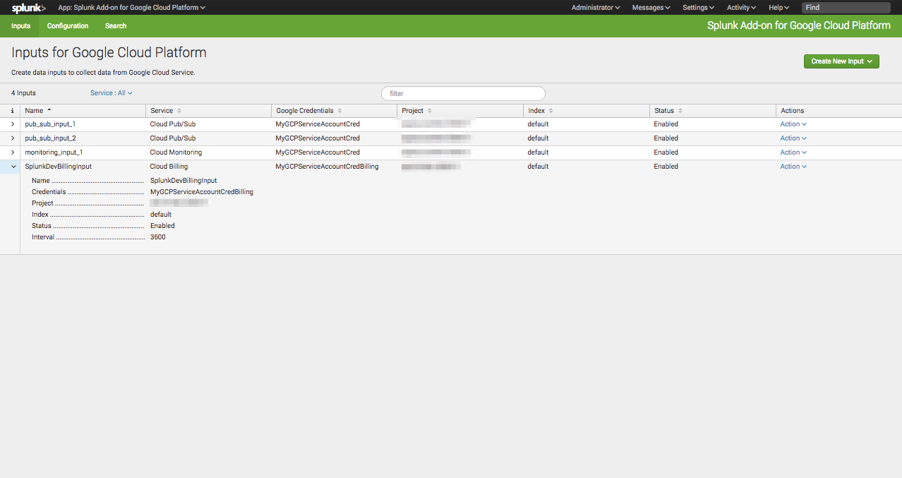
Confirming successful input creation – Part 2
All inputs are visible in the Inputs tab of the Splunk Add-on for GCP, confirm that the settings of the Cloud Billing input you just created are correct and that the status is Enabled.

Slide 64
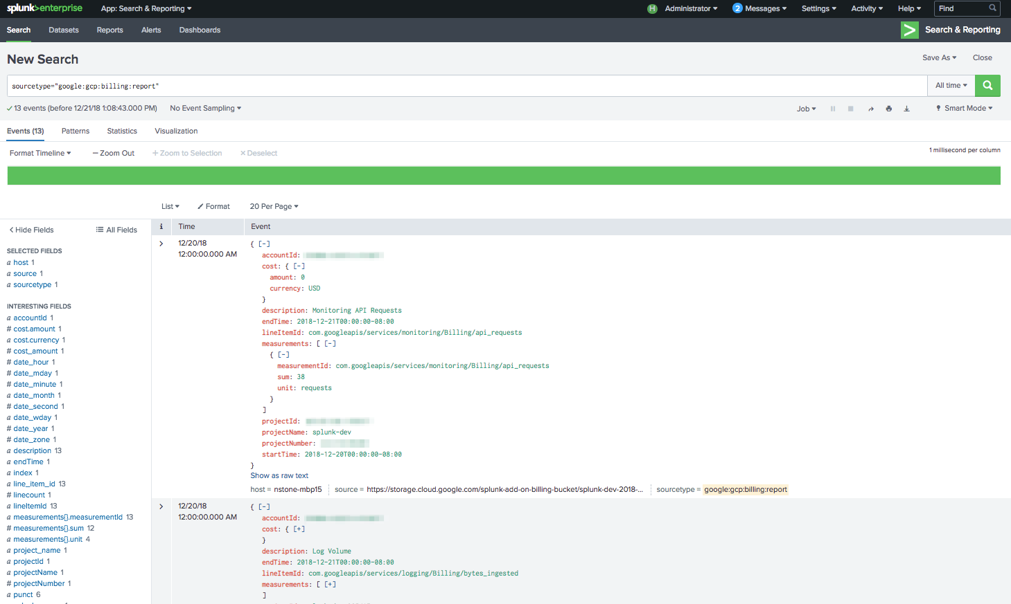
Confirming successful data ingestion using Splunk search – Part 3
Enter sourcetype="google:gcp:billing:report” as your search query in the Splunk search bar. Confirm the time range is valid=. If the input was successfully created, you should see your events
Note: Billing reports are generated on a daily interval (at midnight), the input runs every hour, you will need to wait for the report to be generated and/or the input to run before it is indexed.

Slide 65
Summary: GCP Setup
Summary for GCP Setup
After completing this module you should have:
Configured the Splunk Add-on for GCP with a permission GCP Service account
GCP Cloud Monitoring input/s set up in the Add-on
GCP Pub/Sub input/s set up in the Add-on (Generic or from Stackdriver logging)
GCP Billing report input/s set up in the Add-on
After completing these steps (Configuring at least one of input). You will be able to query GCP data in your Splunk environment

Slide 66
Continue to Module 3: Troubleshooting Add-on inputs

